Slide 1
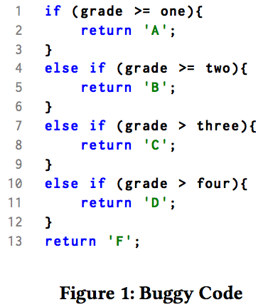
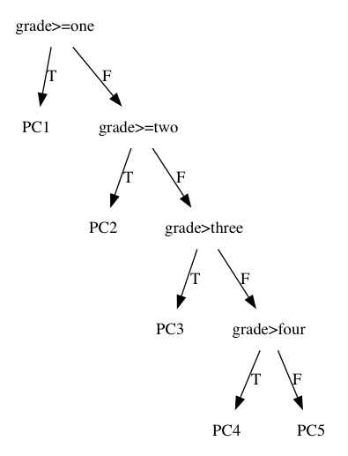
Canonical Search And Repair Andrew Hill¹, Kathryn T. Stolee¹, Corina Pasareanu² ¹North Carolina State University, ²Ames Research Center and Carnegie Mellon Silicon Valley
Problem
Results
CSAR seeks to automatically repair buggy programs by leveraging code reuse. Search for repair templates is accomplished via string metrics on canonical-form path conditions from symbolic execution. For speed, a machine learning algorithm can be used to identify likely incorrect patches without running a test suite. Our learner achieved over 95% precision.
Table 1 gives our numbers of correct patches and the number of plausible patches for all other techniques. Table 2 gives the percentage of attempted patches which resulted in a successful patch.
We show an 8% overall improvement in number of correct patches over state of the art (GenProg 287*(68.7% correct) = 198 vs 214 CSAR), even though we were not able to attempt three of the six programs due to limitations symbolic execution. Additionally, only CSAR can consistently repair grade bugs suggesting that at minimum CSAR is a powerful supplement for problem types which are difficult for existing methods.
CSAR Algorithm
Localize fault, expand to buggy region
Run symbolic execution on buggy region and get path conditions (see symbolic execution tree)
Path conditions to canonical form a la Green [2]
Search DB for matches based on string metrics between canonical representations (e.g. edit distance)
Use string metrics and a decision tree to remove likely incorrect patches
For remaining matches, transform source code to fit code under repair
Run unit tests
Verify correctness of patched code using heldout tests
Symbolic execution of Buggy Code
Conclusion
8% improvement in correct patches over state of the art
47.6% improvement over previous reuse-based approaches (SearchRepair, ssFix)
Only technique which consistently repairs grade
Use of metrics allows finer-grained control than unit tests
Setup
For this work, we used a Java version of the IntroClass dataset, and the Java Symbolic Pathfinder (SPF) symbolic execution engine [1].
References
[1] Păsăreanu, Corina S., et al. "Symbolic PathFinder: integrating symbolic execution with model checking for Java bytecode analysis." Automated Software Engineering 20.3 (2013): 391-425.
[2] Visser, Willem, Jaco Geldenhuys, and Matthew B. Dwyer. "Green: reducing, reusing and recycling constraints in program analysis." Proceedings of the ACM SIGSOFT 20th International Symposium on the Foundations of Software Engineering. ACM, 2012.
Notes:
2/1/18
1
1

